Slide 1


Advisor : Hoon Sung Chwa
Weekly Meeting
2022.12.02
Dept of Information & Communication Engineering, DGIST
Real-Time Computing Lab
Kang Young Eun ( kye0520 @dgist.ac.kr)

Slide 2
Contents
Motivation
Review
Overview
To Do
2

Slide 3
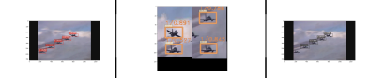
Motivation
Problem Statement
Solve the tradeoff between detection accuracy and execution time in object detection with multiple cameras.
Main Idea : Patching
Example of Image Patching
Frame t
Patched image
Frame t+1
3

Slide 4
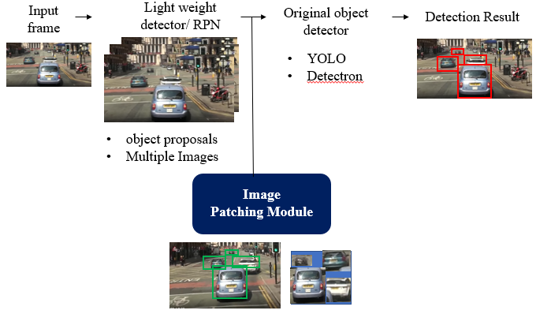
Review
Light-weight Region Proposal Method
mmDetection RPN backbone
detectron2 ResNet50-FPN
ResNet18 , ResNet32, ResNet50
4

Slide 5
Review
Light weight Region Proposal Method
Detection Accuracy
5

Slide 6
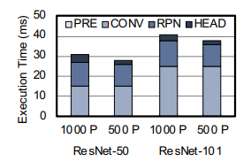
Execution Time breakdown
Execution time of Patching
1290x1290 image to 960x960 image with no object scale change
Execution time
6
Notes:
다음은 Execution time 측정 결과입니다.
지난번 rpn 측정 값이 누락.
Rpn이 같은 크기의 yolo detection 결과랑만 비교 했을 때 절반 가량 detection 시간을 줄일 수 있는 것으로 확인되었습니다.
이 detection latency 부분이 deadline에 따라서 dynamic하게 조절할 수 있는 부분이고 지금 비교적 큰 size의 이미지로 detection 진행했기 때문에 이보다 작게 줄이면
Total 실행시간을 크게 줄일 수 있을 것으로 보입니다.

Slide 7
Faster R-CNN
Patching Impact on Faster R-CNN
7
7
7

Slide 8
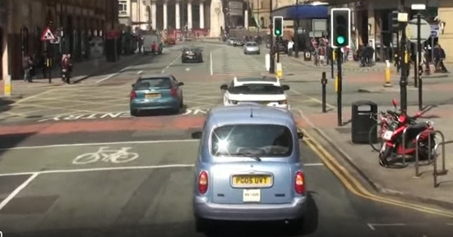
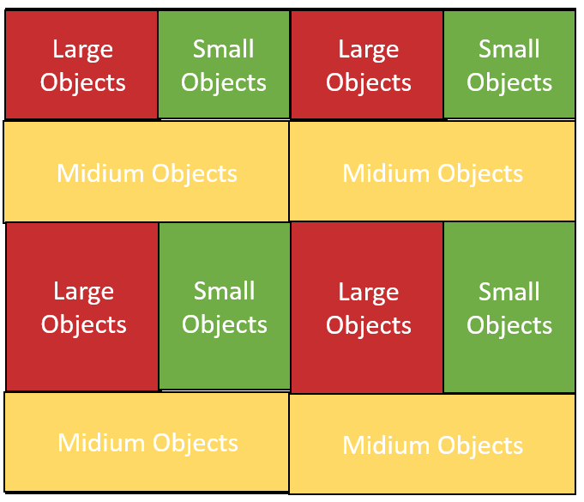






Overview
2. Overview of exploiting consecutive frame feature
$$F_{1}$$
$$F_{1}$$
Detection
Network
(Yolo)
$$F_{2}$$
Frame Ordering Module
.
.
.
.
.
.
$$F_{2}$$
.
.
.
.
.
$$F_{n}$$
Multiple Input Images
update
$$F_{n}$$
Patching Module
New Object Detection
8
Tracker

Slide 9
Multi camera object detection
Execution time in case of multi camera
9

Slide 10
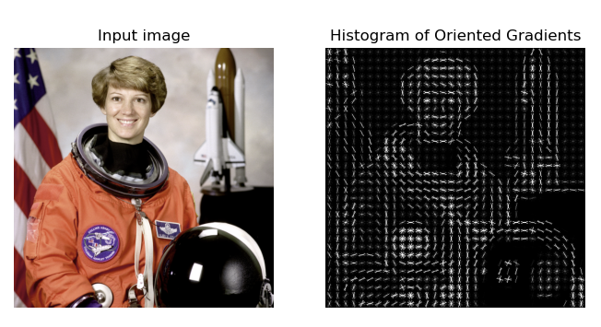
Region proposal method
Traditional Object detection method
HOG Detector
DPM
HOG feature vector extraction example
10

Slide 11
Summary
Light weight Region Proposal Method
Faster R-CNN
Light weight non DNN method
Consecutive Frames
11

Slide 12
To Do
Region Proposal
Light weight methods
Patching implementation
Frame Selection Module Algorithm
12
12
12

Slide 13

Advisor : Hoon Sung Chwa
Thank you
Dept of Information & Communication Engineering, DGIST
Real-Time Computing Lab
Kang Young Eun (kye0520@dgist.ac.kr)

Slide 14



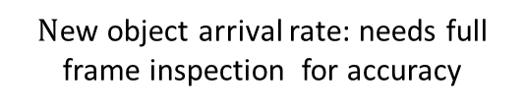

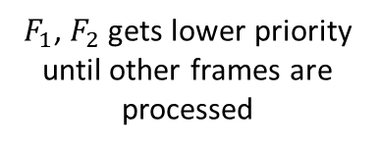

Frame Selection Module
Frame Selection Mechanism
Output : order of frames or window size per frame
Decides number of possible number of images for full frame inspection according to deadline
Exploits consecutive frame info
1. Available full frame inspection until deadline: 2
Detection
(Yolo)
$$F_{1}$$
$$F_{1}$$
$$F_{2}$$
Frame Priority Ordering Module
.
.
.
$$F_{2}$$
$$F_{n}$$
$F_{1}$, $F_{2}$ gets lower priority until other frames are processed
Selected Frames
Multiple Input Images
$N$ew object arrival rate: needs full frame inspection for accuracy
14
Notes:
Full frame inspection을 frame당 얼마나 자주 누구 frame 부터 하는 것이 적당한지

